Slide 1
GARBY
Group Members:
AHAMED - CODSE172F-012
PASINDU - CODSE172F-023
PADMAKANTH - CODSE172F-032
DEVIN - CODSE172F-051

Slide 2
Introduction
Today the world is moving towards automated robots and AI technologies which replace human beings for multi-task activities. The essence of learning and applying state-of-art technologies is paramount to upgrade the living standards. To facilitate the above ideology, the project “Automated garbage collecting robot (Garby)” was initiated.
Conclusively, the project scope is focused on building a working prototype with the basic functions which includes basic movements of robot and the arm, image processing task and fundamental embedded system development.

Slide 3
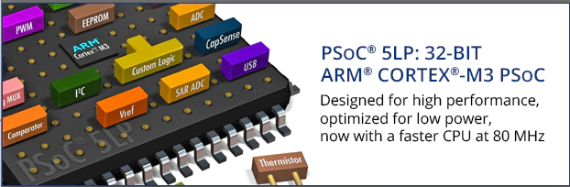
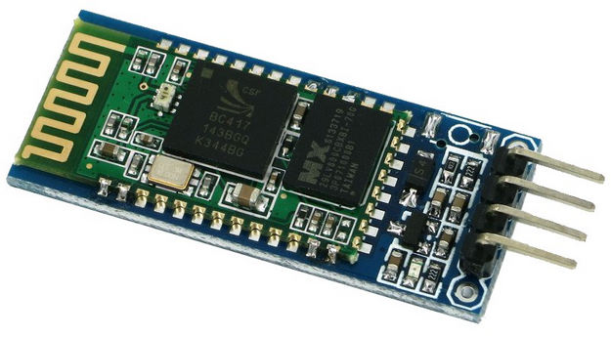
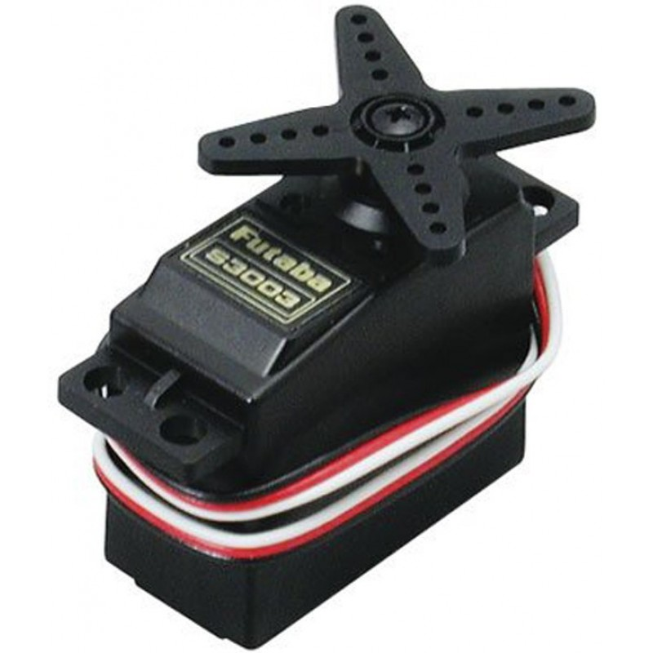
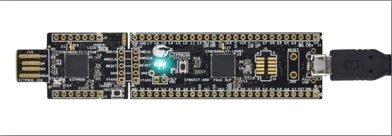
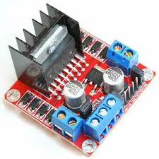
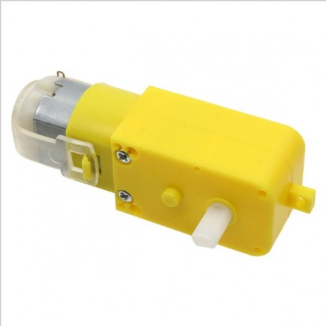
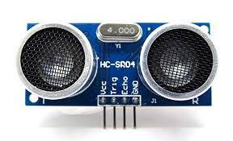
Components
PSoC OR Arduino
Power Supply
Servo Motors
Motor Driver l298N Dual
DC Motors
Ultrasonic Sensor
HC-06 Bluetooth Module
Jumper Wires

Slide 4
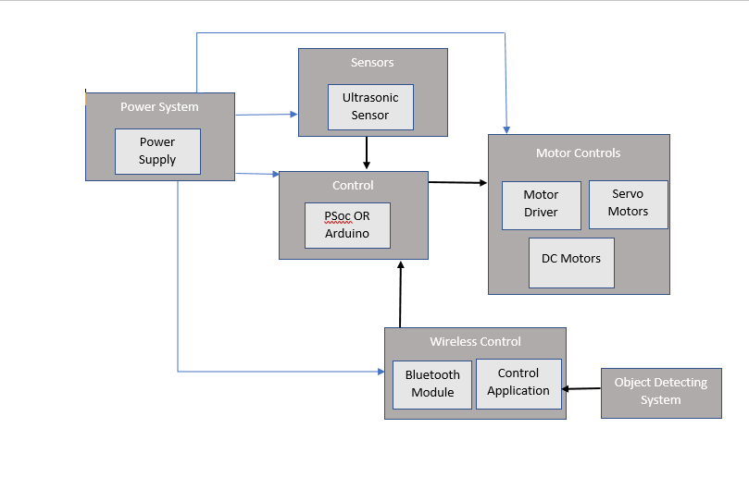
Block Diagram

Slide 5
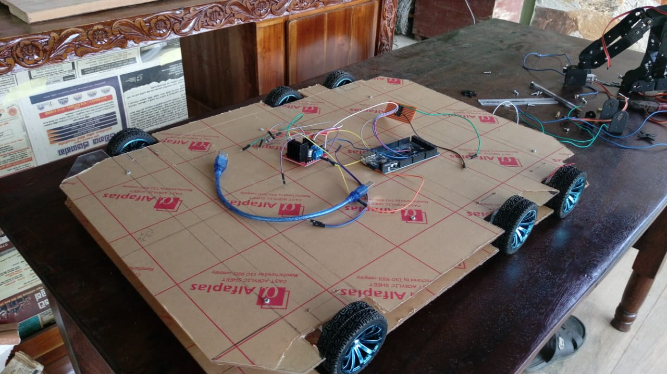
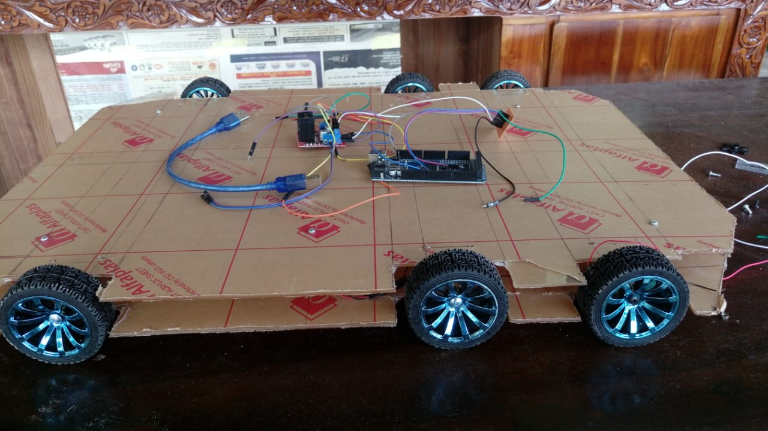
Developing

Slide 6
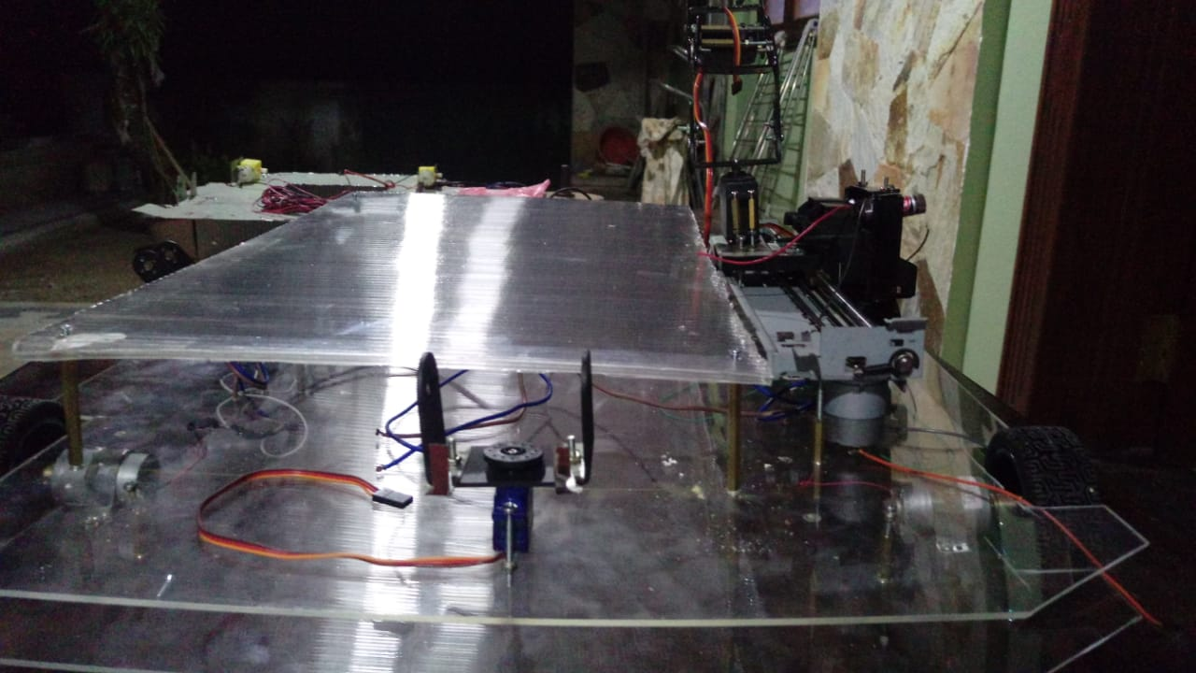
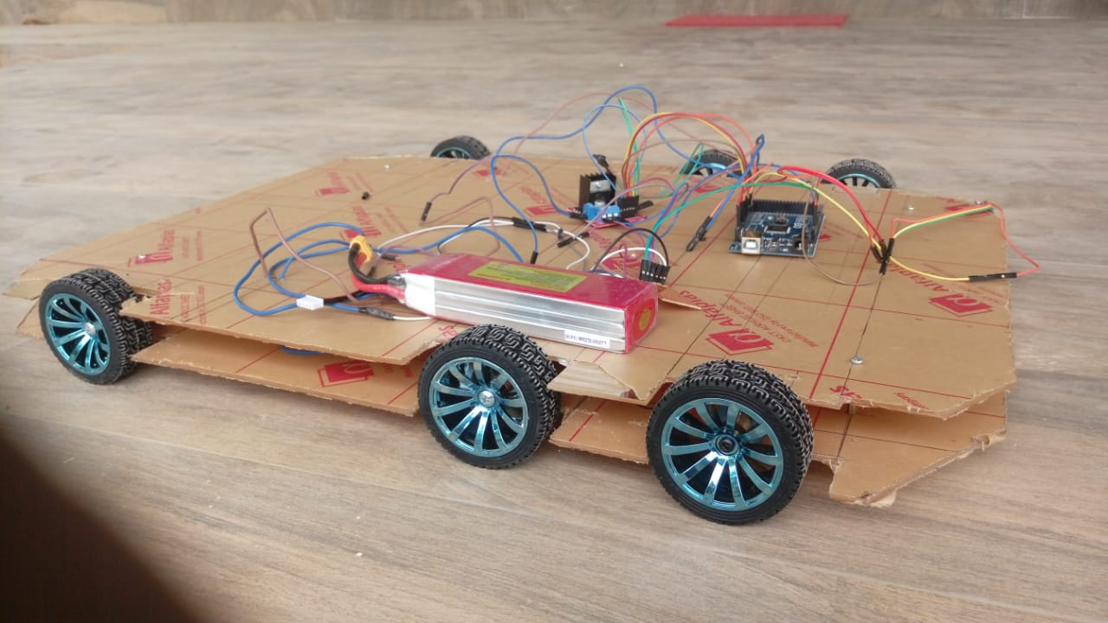
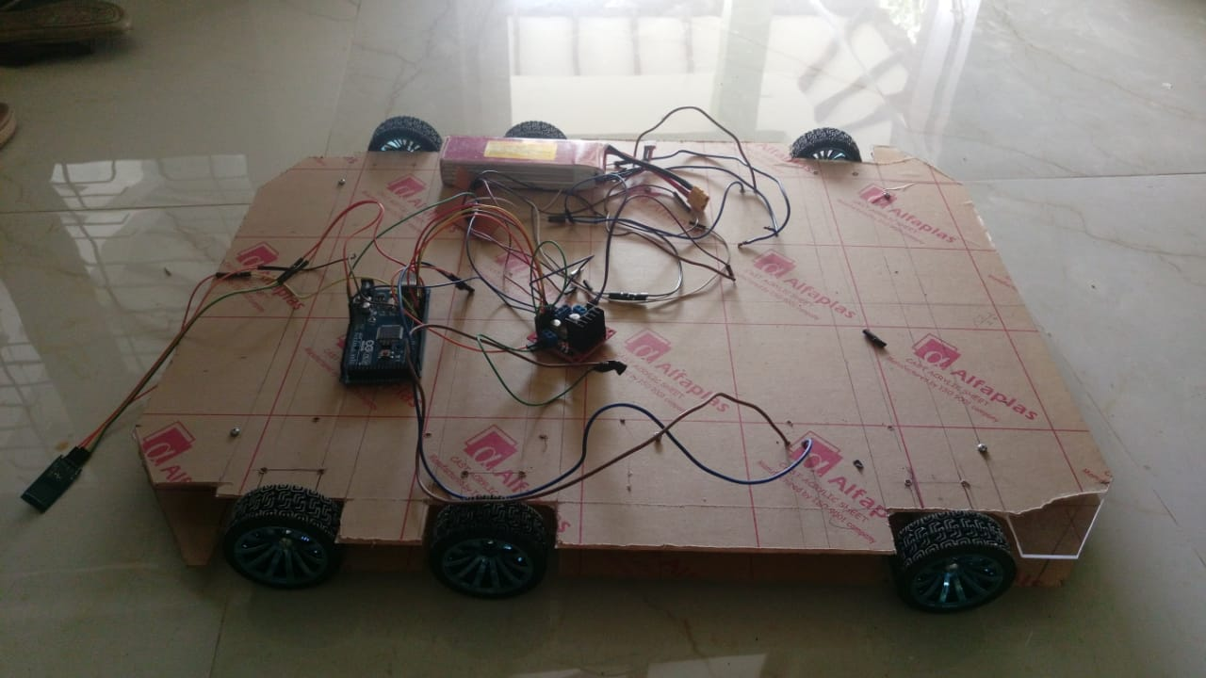
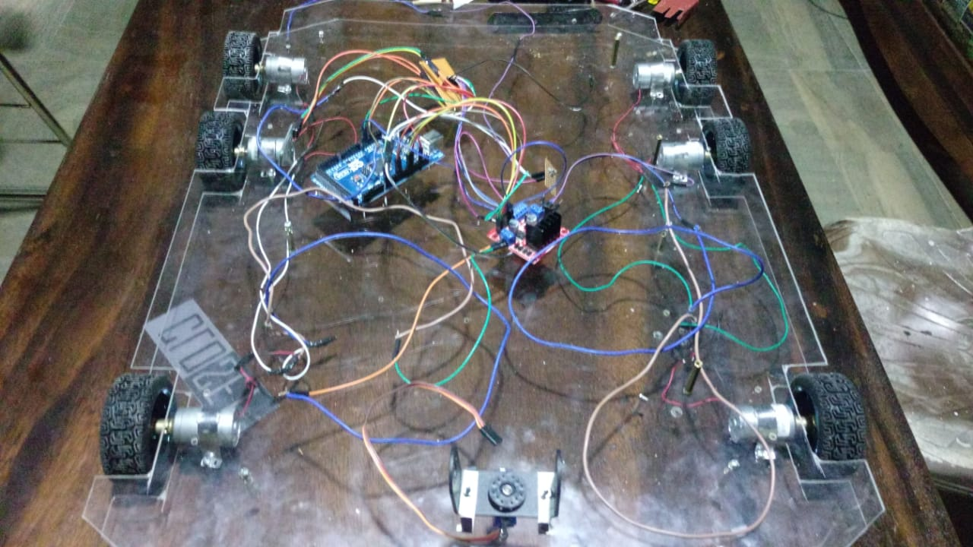

Slide 7
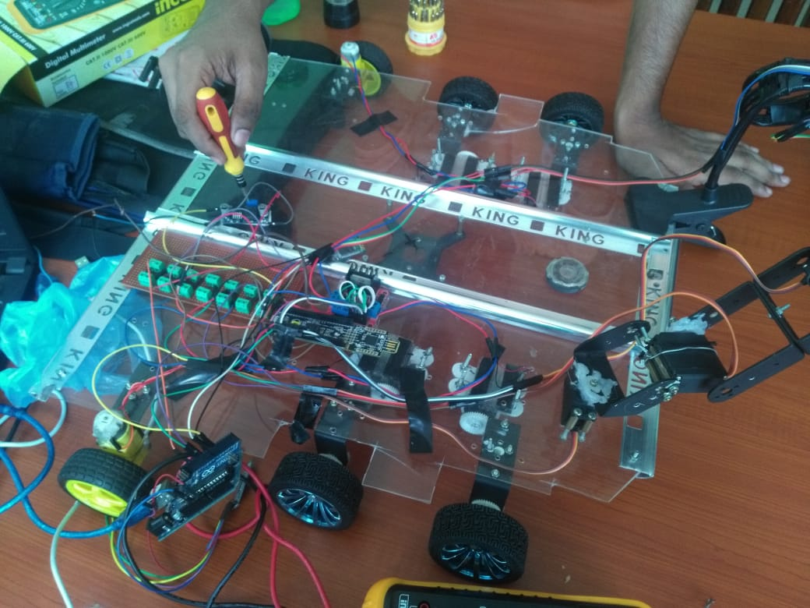
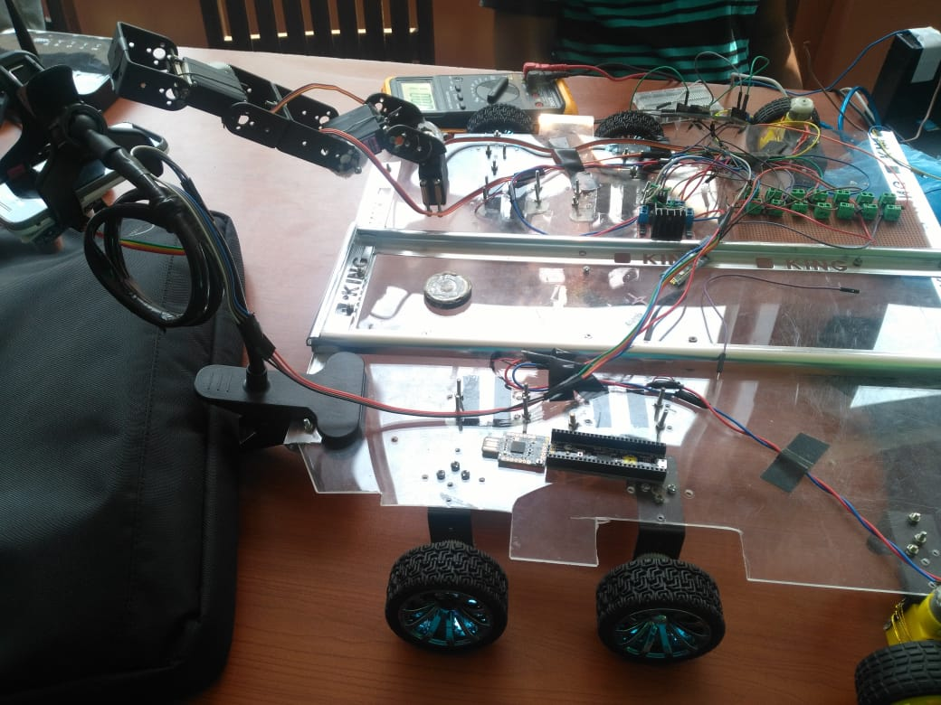
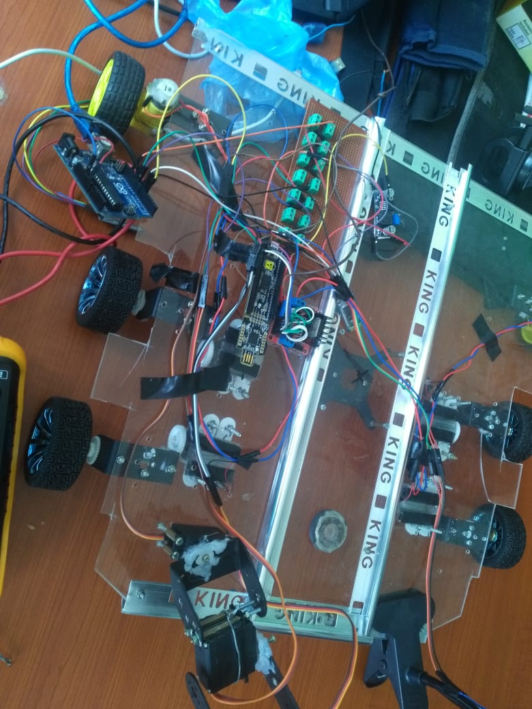
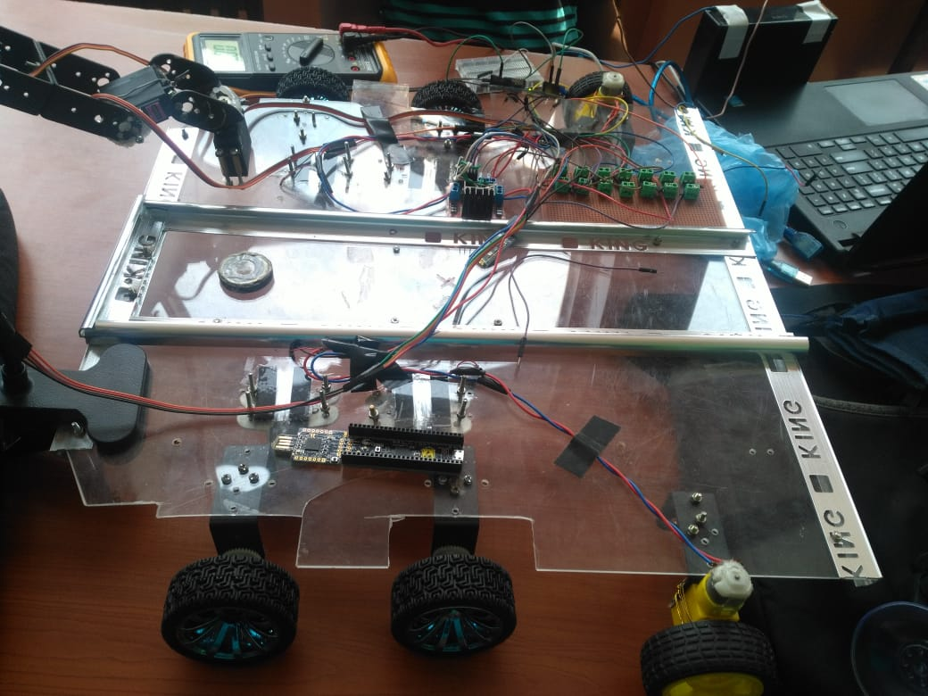

Slide 8
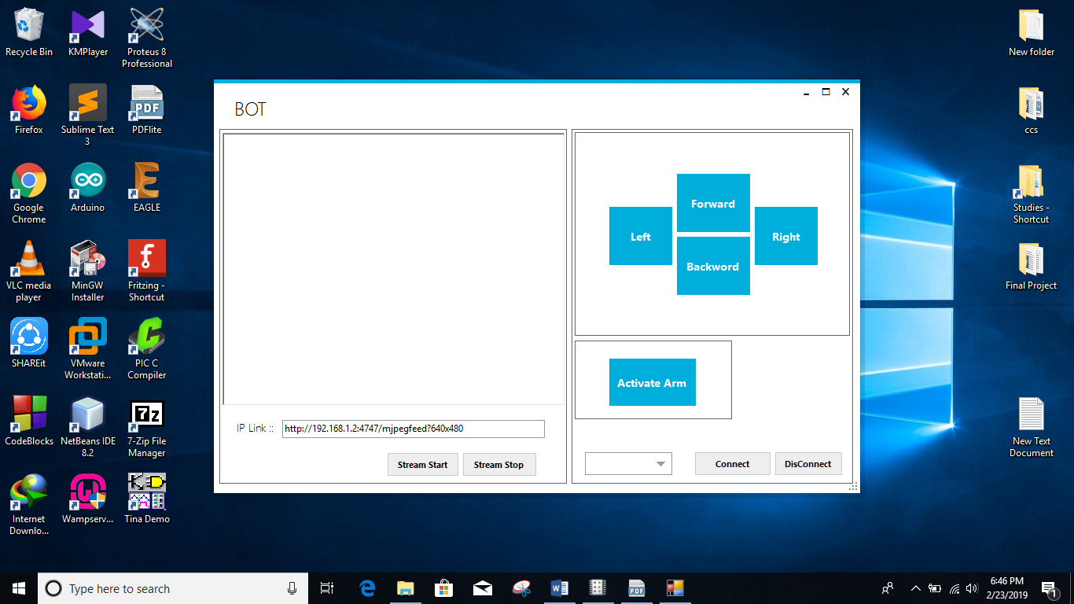
Control Application

Slide 9
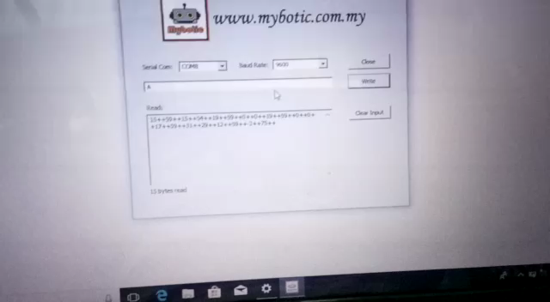
Testing the Arm

Slide 10
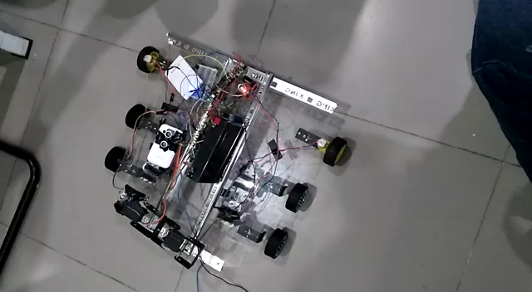
Testing the vehicle

Slide 11
Future Works
Development of ROS, AI algorithms necessary for proper decision taking on the image processed.
Enhancement of the performance of the present robots with applied feedback controls to the motor and with better Kinematics models.
Application of better Embedded System modules and Microcontrollers (Raspberry Pi).
Production of commercially viable robot with all the necessary documents included.

